Slide 1





The Wildfires
in Canada
CAROLINE BORDIN BASTOS, JASMINE BAMBA &
NIKITA GAHOI

Slide 2




Objective
To investigate the potential correlation between wildfire frequency and the months of the year.
To track and visualize the historical number of wildfires in Canada over the years.
To assess the impact of deforestation on fire spread patterns compared to natural forested areas.

Slide 3
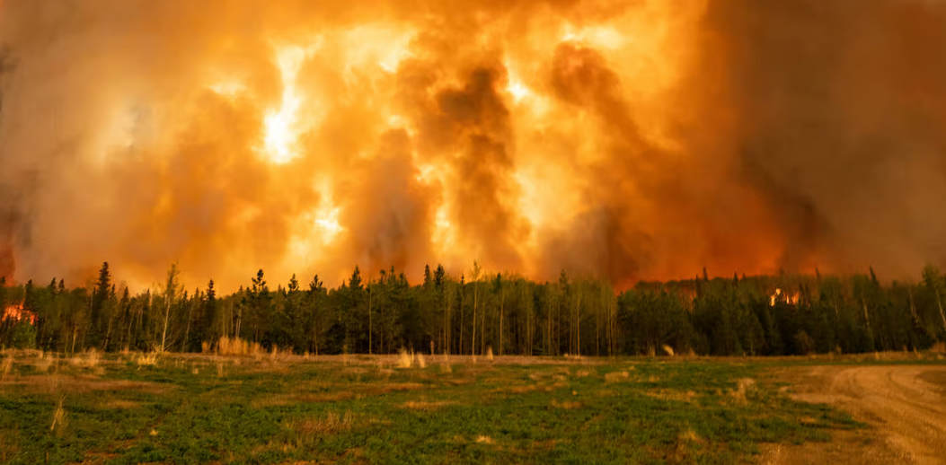
Between 1990 and 2020, there were about 221,272 in Canada, burning an area of around 74.5 million hectares of its territory.

Slide 4


Wildfire Data (1990-2020)
Deforestation and CO2
emission (2000-2020)

Slide 5

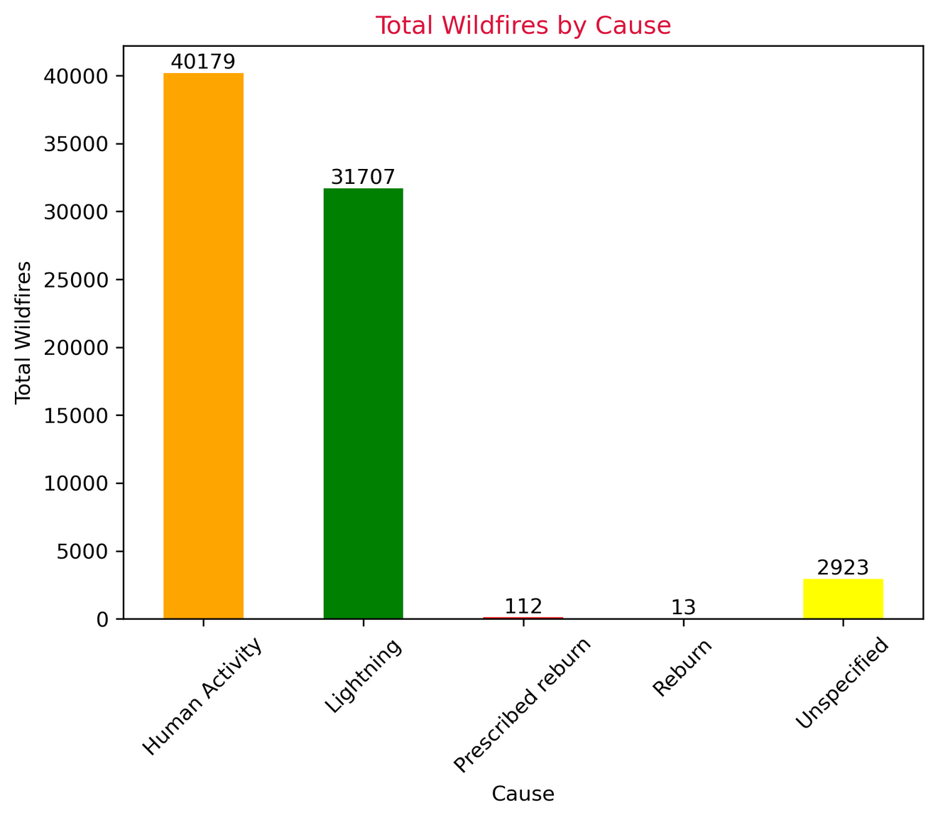

Causes of
Wildfires
Human activity is the leading cause of wildfires in Canada followed by Lightning

Slide 6
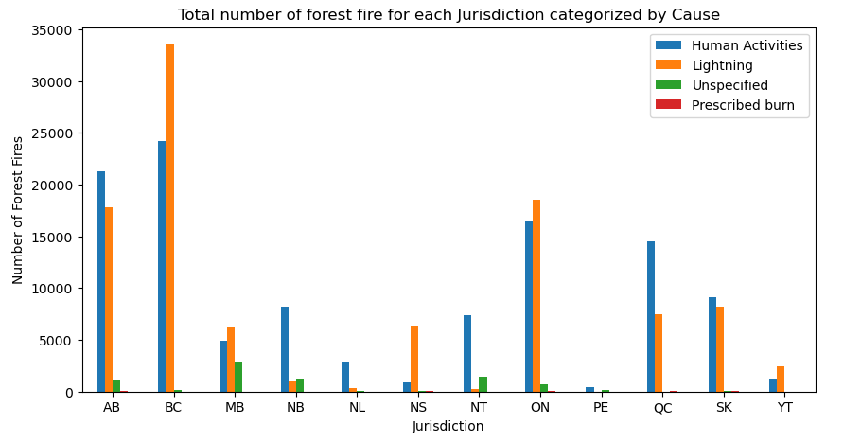
- The major cause of wildfire in British Columbia and Nova Scotia is lightning
- On the contrary, In Alberta, New Brunswick and Quebec, the main cause of wildfire is Human Activities

Slide 7

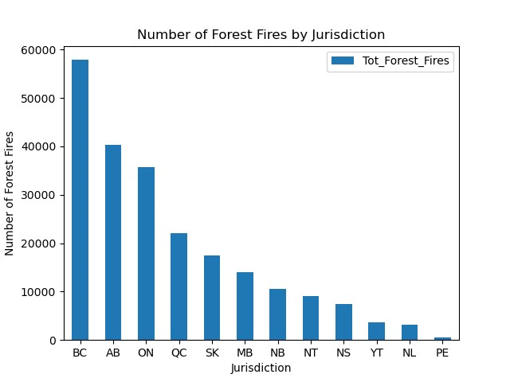
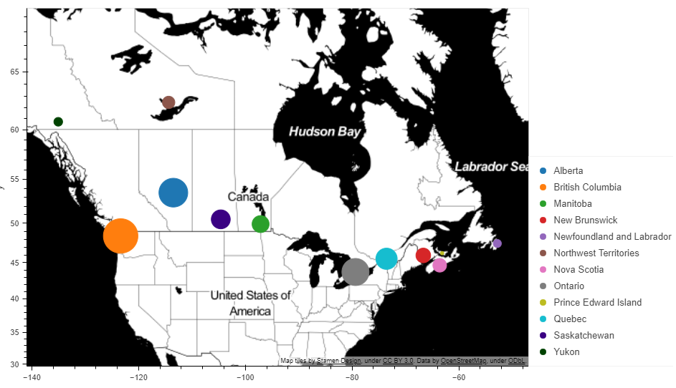
The provinces
In the past 31 years, BC has experienced the maximum number of forest fires, followed by Alberta and Ontario
The Jurisdiction with the least number of Wildfires are Prince Edward Island, Newfoundland and Labrador and Yukon

Slide 8

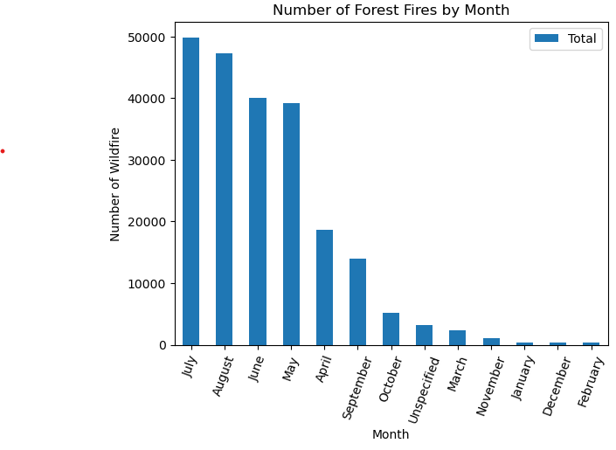
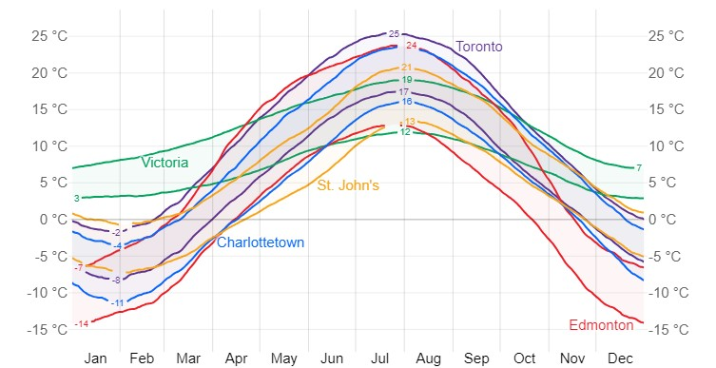
The months with the most wildfires occurances
July and August witnessed the maximum number of wildfires from 1990-2020, followed by June and May
@WeatherSpark.com

Slide 9
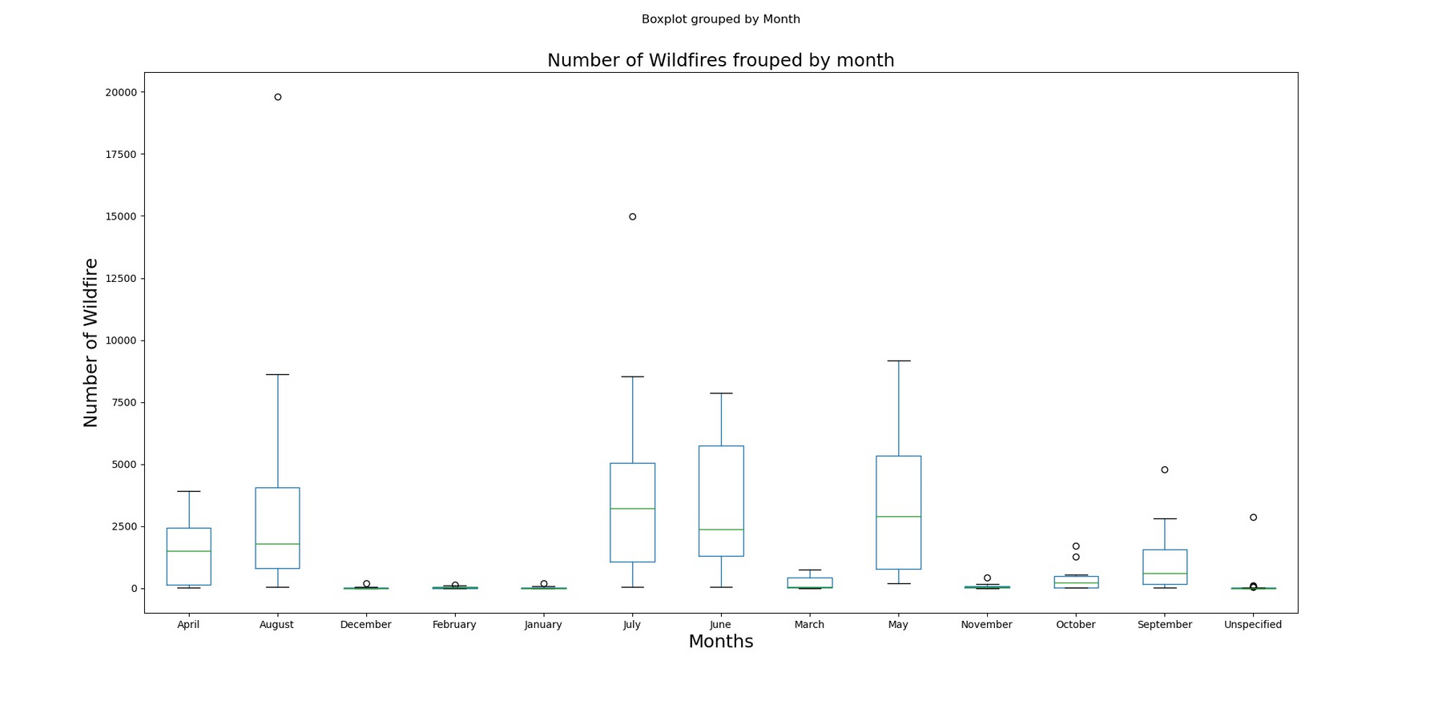
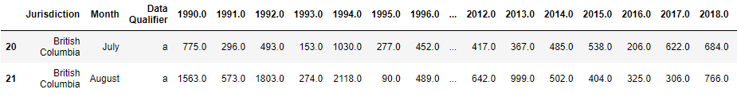
The months with the most wildfires occurances

Slide 10

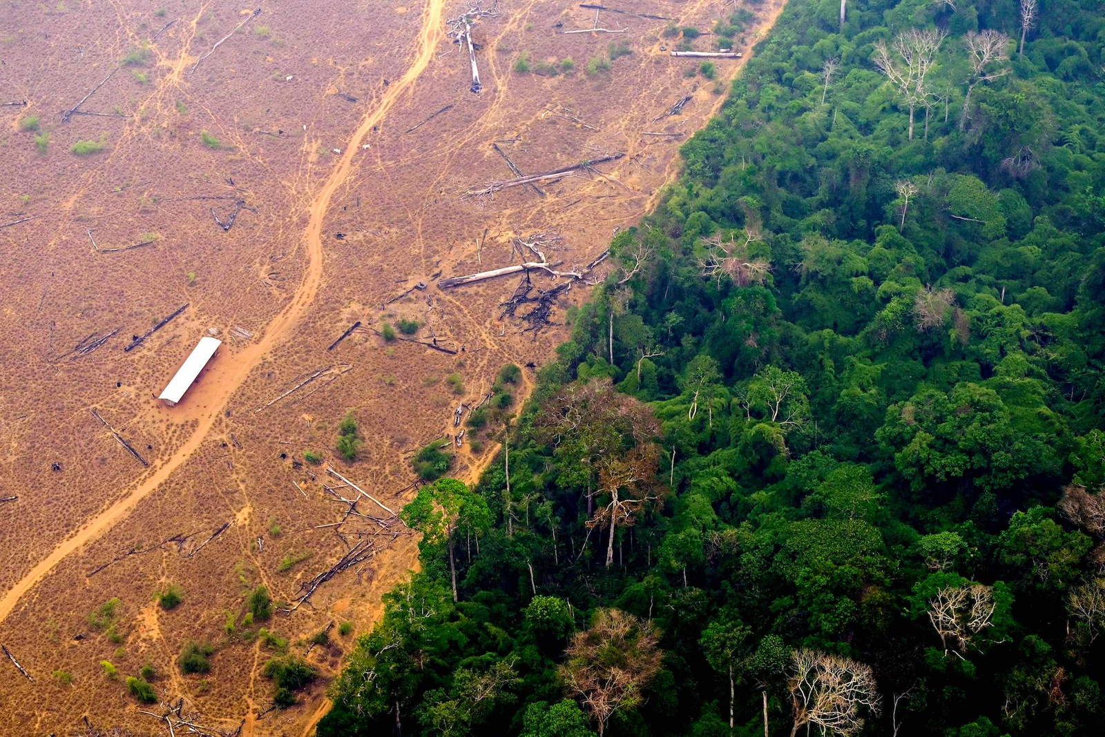
Deforestation
Deforestation is the intentional destruction of forested land for alternative purposes.
Between the period of 2000 to 2021, Canada lost more than 44 milion hectares of tree cover.

Slide 11
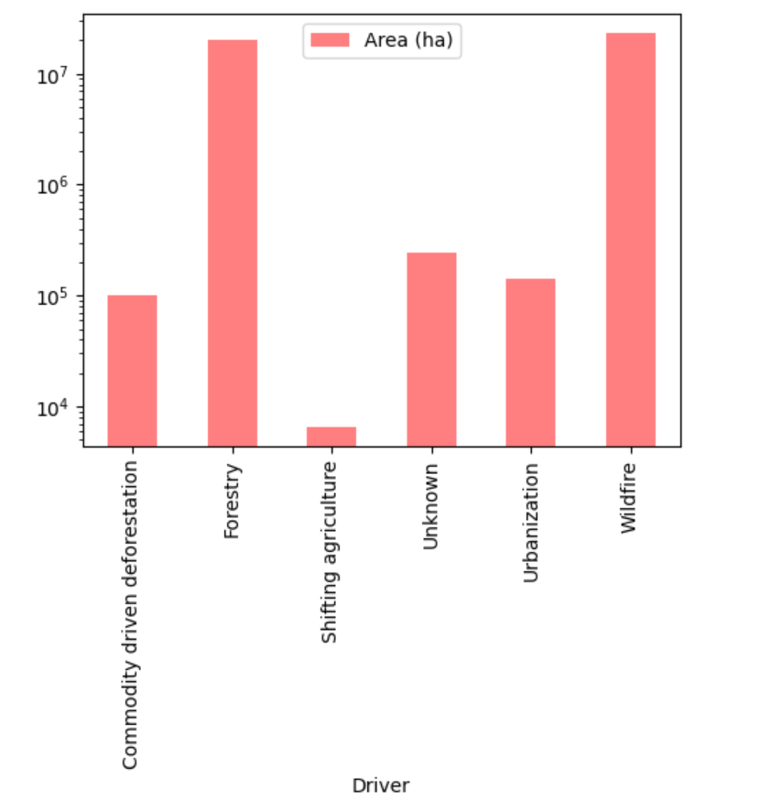

Several factors cause deforestation in Canada, including agriculture and mineral extraction.
The wildfires and forestry are the main factors, representing more than 98% of the causes.

Slide 12

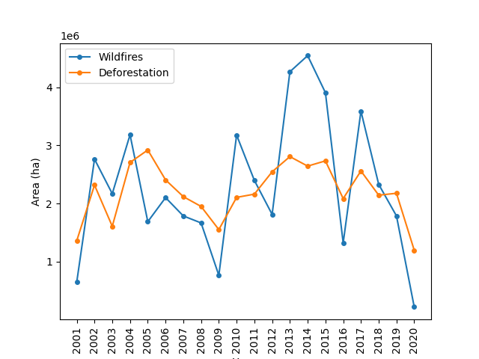

Deforestation contributes to increased fire risk in surrounding woodland.
Reducing tree cover and ground vegetation dries out forests, especially tropical rainforests.
This leads to a greater risk of fire in the area around a deforested zone.

Slide 13

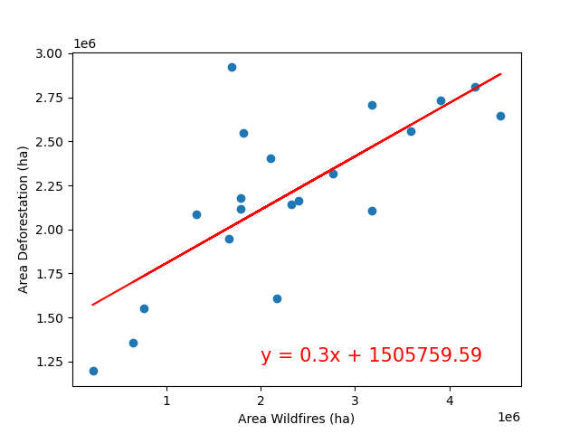

Linear Regression
The r-value is 0.7395928,
showing a strong positive correlation between these factors.

Slide 14


Conclusion
Major causes of wildfires in Canada are Human Activities (53.6 %) and Lightning (42.3%)
British Columbia has experienced the maximum number of forest fires across all the jurisdictions and the main factor being lightning
In Alberta, New Brunswick, and Quebec, the main cause of wildfire is Human Activities
The months with the highest temperatures in Canada (July and August) witnessed the maximum number of wildfires
A positive correlation was observed between the deforestation area and the area burnt by wildfires

